Slide 1
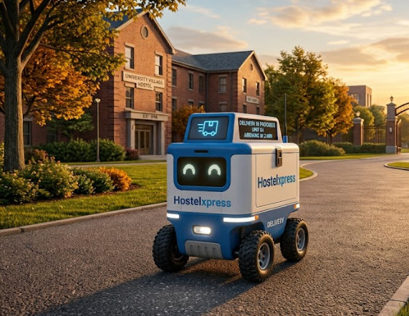
Hostelxpress
Problem Statement : “The lack of an efficient last-mile delivery system forces hostel students to spend time and effort travelling from their hostels to the campus gate to collect deliveries.”

Slide 2
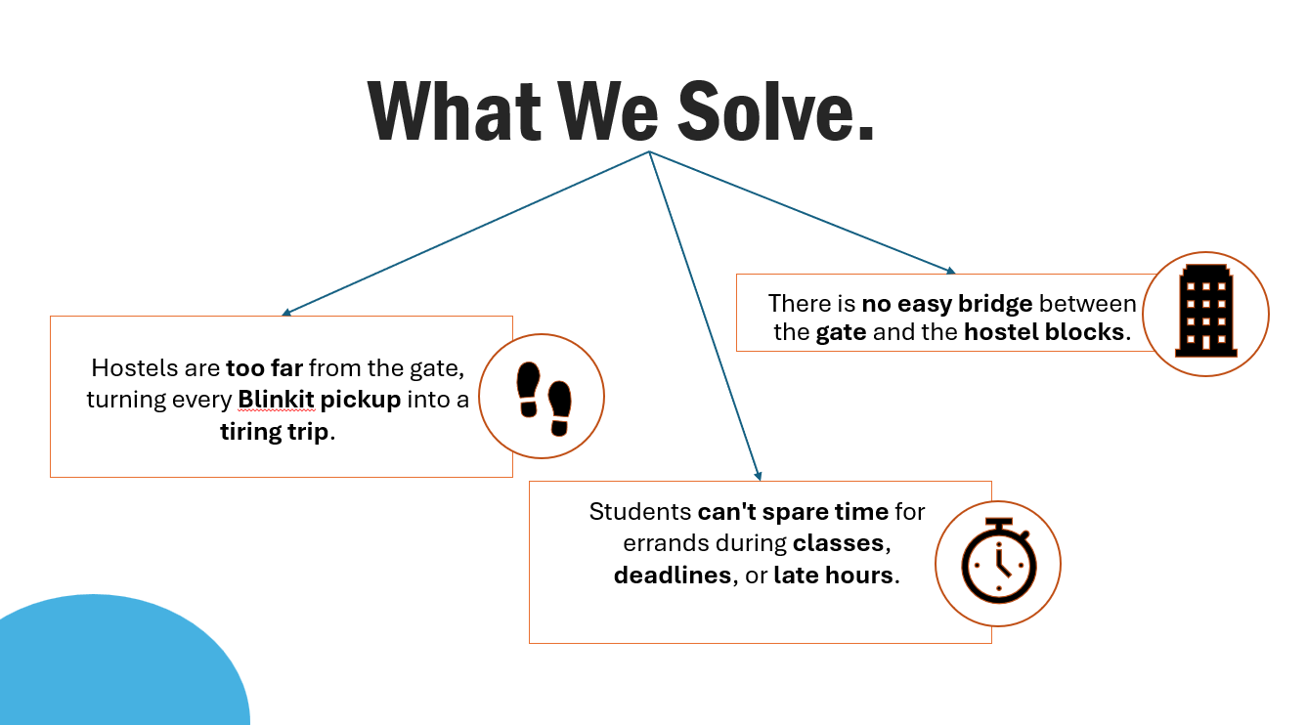
What We Solve.
There is no easy bridge between the gate and the hostel blocks.
Hostels are too far from the gate, turning every Blinkit pickup into a tiring trip.
Students can't spare time for errands during classes, deadlines, or late hours.

Slide 3
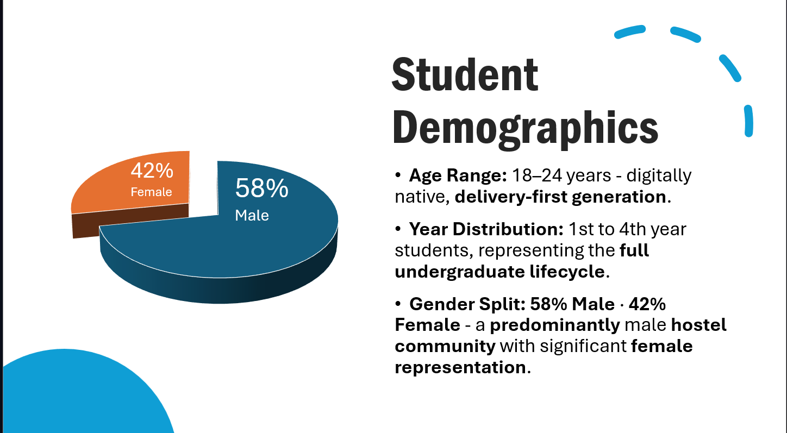
Student Demographics
Age Range: 18–24 years - digitally native, delivery-first generation.
Year Distribution: 1st to 4th year students, representing the full undergraduate lifecycle.
Gender Split: 58% Male · 42% Female - a predominantly male hostel community with significant female representation.

Slide 4
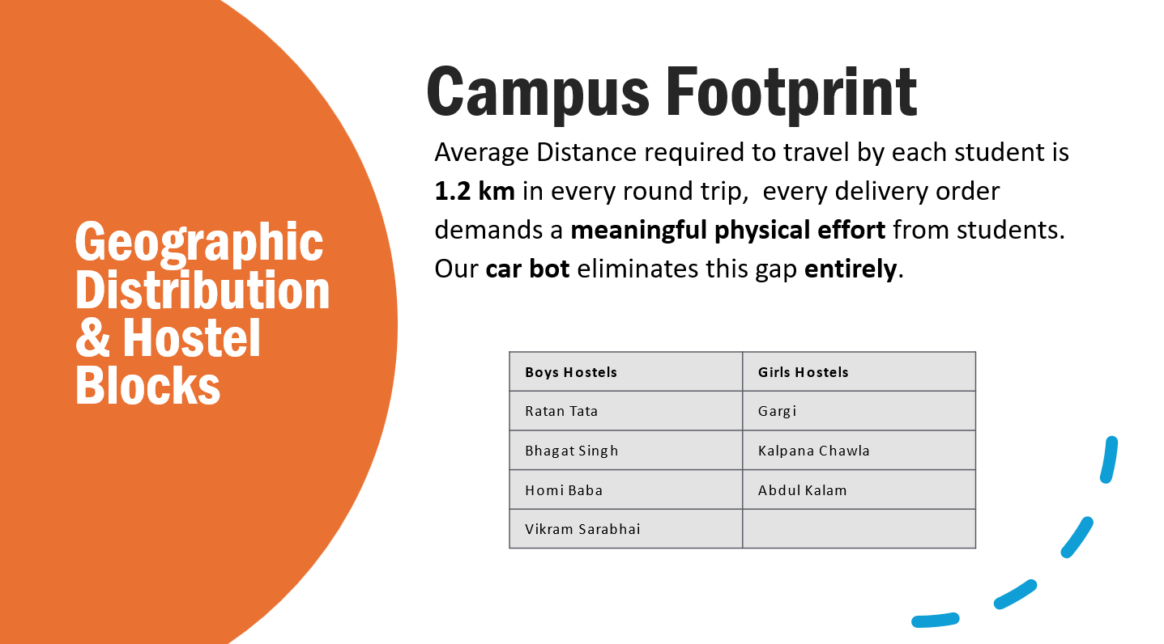
Campus Footprint
Geographic Distribution & Hostel Blocks
Average Distance required to travel by each student is 1.2 km in every round trip, every delivery order demands a meaningful physical effort from students. Our car bot eliminates this gap entirely.
Boys Hostels | Girls Hostels
Ratan Tata | Gargi
Bhagat Singh | Kalpana Chawla
Homi Baba | Abdul Kalam
Vikram Sarabhai

Slide 5
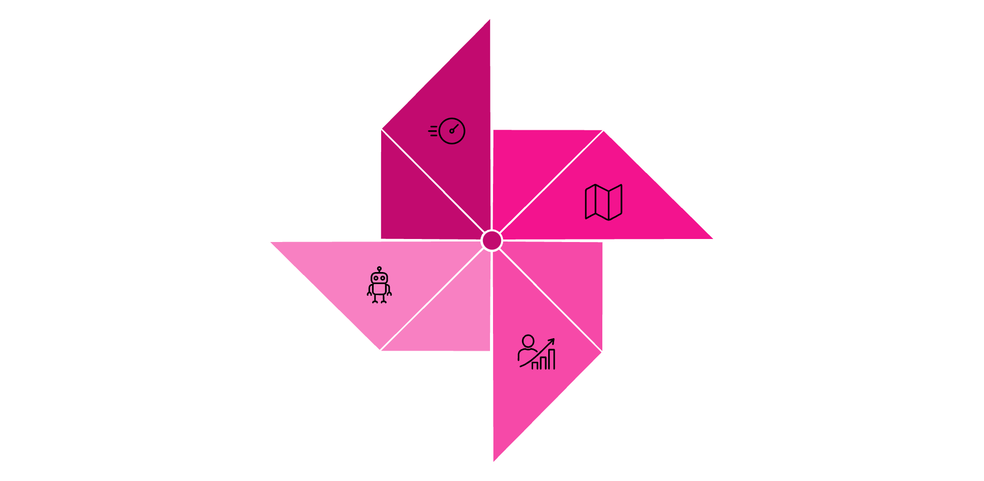
Our Solution: The 3S Framework
Scope
Speed
Car bot delivers parcels in minutes, not hours - right from the gate to the hostel door.
Covers all 7 hostel blocks with seamless, optimised gate-to-hostel routes - no block left behind.
Car Bot Core
Scalability
The autonomous delivery solution powering the entire ecosystem.
Easily expands to handle peak demand and future campus growth - built to grow with the student community.

Slide 6
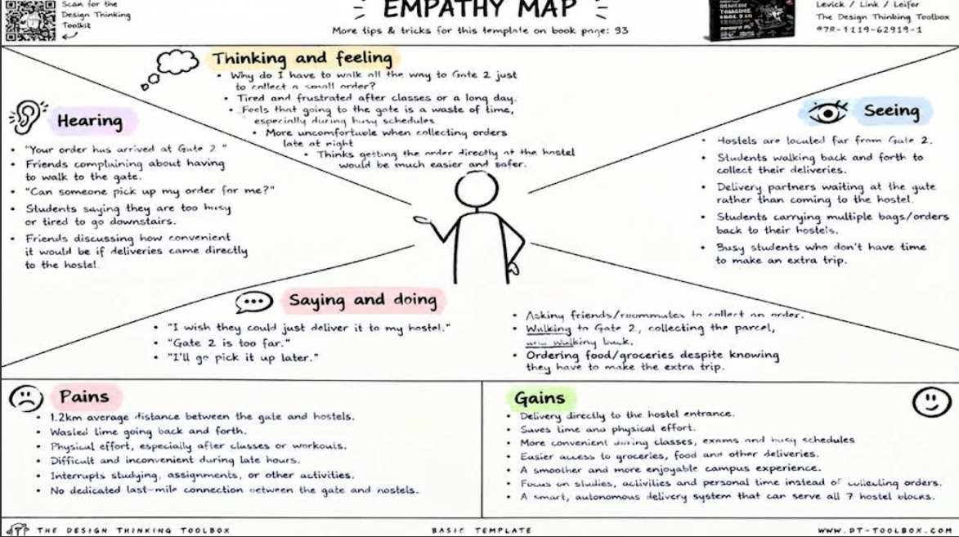

Slide 7
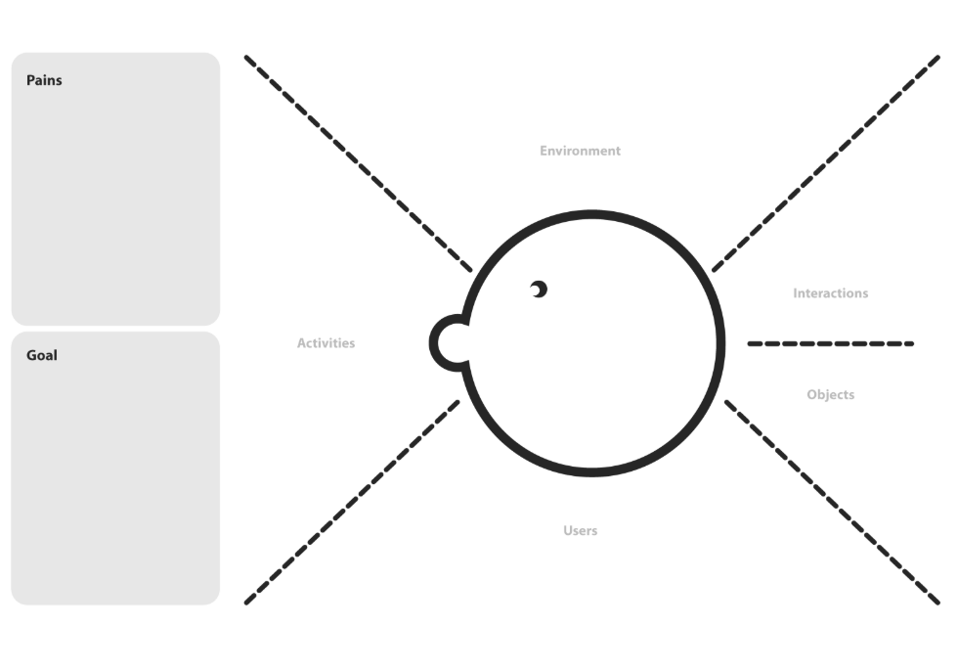
ENVIRONMENT
Ratan Tata
Bhagat Singh
Homi Baba
Vikram Sarabhai
Kalpana Chawla
Abdul Kalam
Gargi
Average gate-to-hostel distance: about 1.2KM for each round
Hostel walkways, pathways and internal campus roads
Peak periods: evening and early morning hours
1.2km average distance between the gate and hostels.
Wasted time going back and forth.
Physical effort, especially after classes or workouts.
Difficult and inconvenient during late hours.
Interrupts studying, assignments, or other activities.
No dedicated last-mile connection between the gate and hostels.
INTERACTIONS
Student -> Delivery partner
Student -> Delivery app
Student -> Autonomous delivery bot / cart
Delivery partner -> Gate 2 handover
Student -> Roommate/friend
Bot <-> Navigation system
Bot <-> Campus environment
ACTIVITIES
Students use smartphones for food and grocery delivery apps.
Receiving arrival notifications that the order has reached Gate 2.
Students walk from the hostel to Gate 2.
They handle and collect the parcel.
They carry the parcel back to their hostel.
Some students ask a roommate or friend to collect the parcel.
With Campus Delivery, delivery partners drop the parcel at the gate to be taken to the hostel.
Eliminate the Last-Mile Gap: Bridge the 1.2km distance between the gate and the hostels to remove the physical effort and frustration of manual pickups.
Enhance Convenience & Safety: Provide a reliable delivery experience that operates safely during late hours, difficult weather conditions, and peak periods (evenings and early mornings) without interrupting students' studies or rest.
Automate the Handover Process: Utilize autonomous delivery carts or bots equipped with navigation and obstacle sensors to transfer orders from external delivery partners at Gate 2 directly to the students at their respective hostel drops.
Reclaim Student Time: Eliminate the wasted time spent walking back and forth, allowing students to focus their energy on academics, assignments, and personal activities.
OBJECTS
Smartphones and delivery app
Food/grocery parcel
Order status / notification
Delivery partner
Navigation system
USERS
Hostel students (primary users).
Students aged about 16-24.
1st-4th year undergraduate students.
Food and grocery delivery agents.
Delivery partners.
Campus security personnel.
Future: wider campus community.

Slide 8
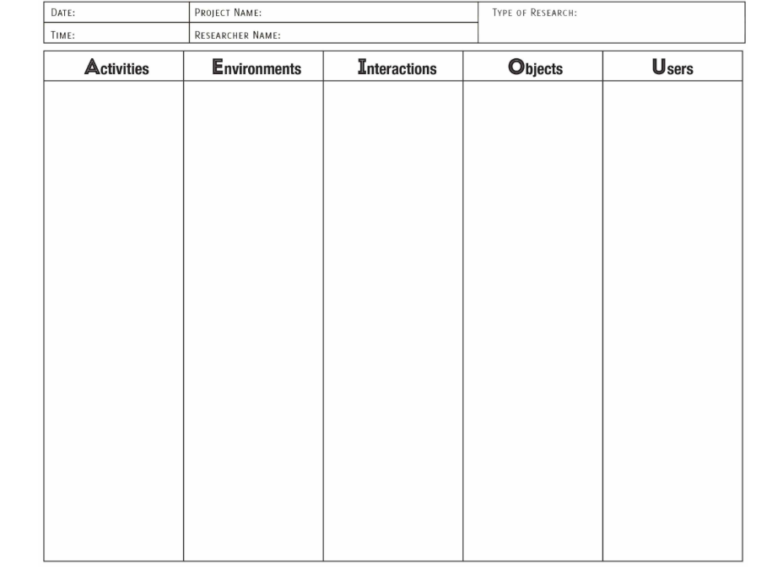
Placing food and grocery orders online
Receiving arrival notifications
Walking to Gate 2 for pickup
Collecting the parcel and verifying details
Walking back to the hostel
Asking friends or roommates for help when busy
Waiting at the hostel for delivery
Using a bot-based delivery service
Main Gate / Gate 2
Hostel blocks and entrances
Campus roads and pathways
Boys' and girls' hostels
Average gate-to-hostel distance of about 800 m
Evening and morning peak periods
Various lighting and weather conditions
Indoor/outdoor handover points
Student -> Delivery partner
Student -> Delivery app
Student -> Autonomous delivery bot/cart
Delivery partner -> Gate 2 handover
Student -> Roommate/friend
Bot <-> Navigation system
Bot <-> Campus environment
Smartphone
Delivery app
Food and grocery parcel
Order ID / notification
Gate 2 handover post
Autonomous delivery cart/bot
Navigation and obstacle sensors
Delivery and charging system
Hostel drop-off point
Hostel students (primary users)
Students aged about 16-24
1st-4th year undergraduate students
Food and grocery delivery agents
Delivery partners
Campus security personnel
Campus delivery operations
Future: wider campus community

Slide 9
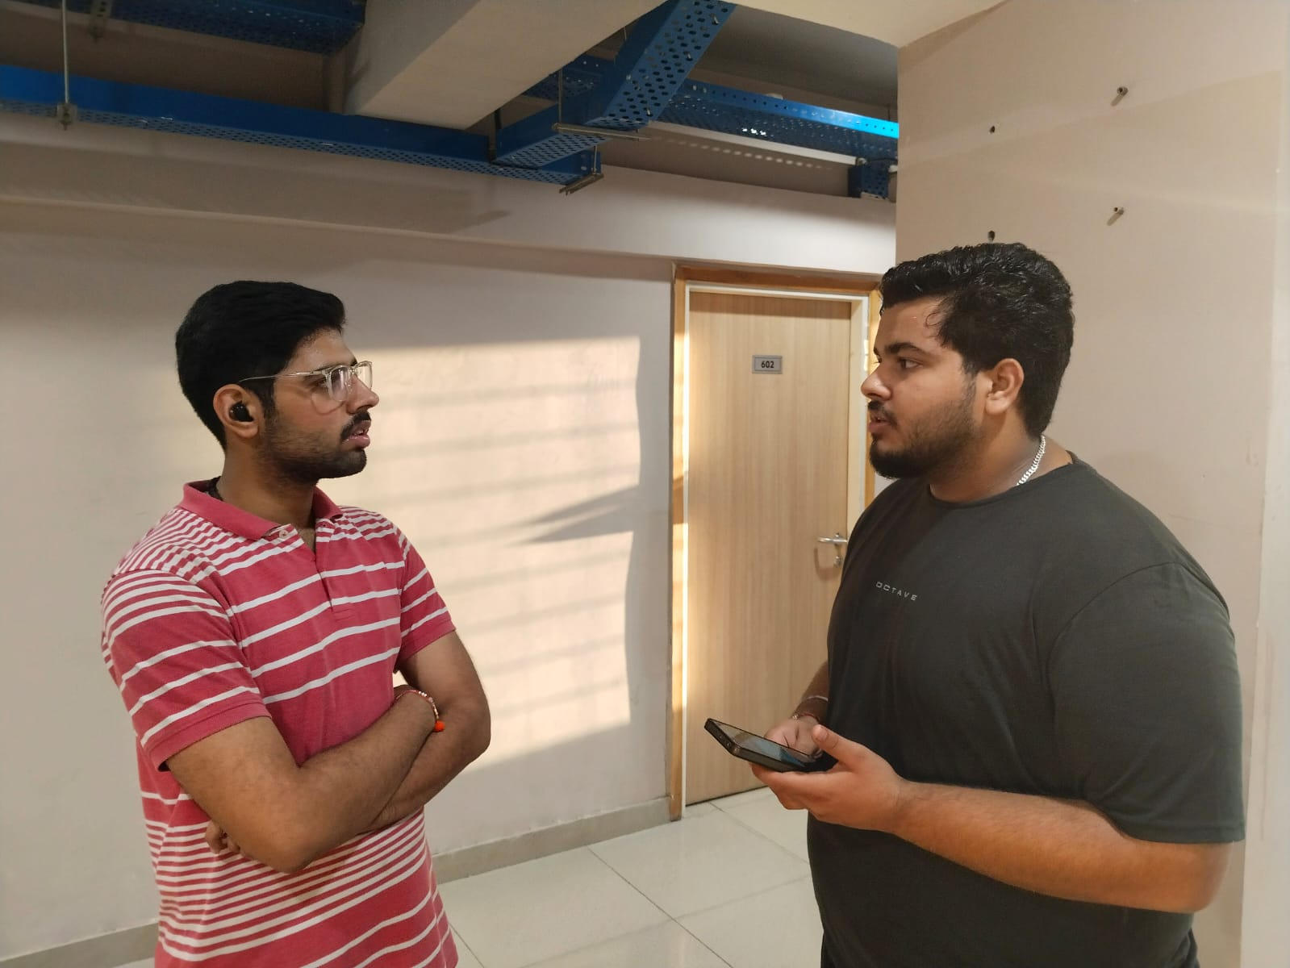
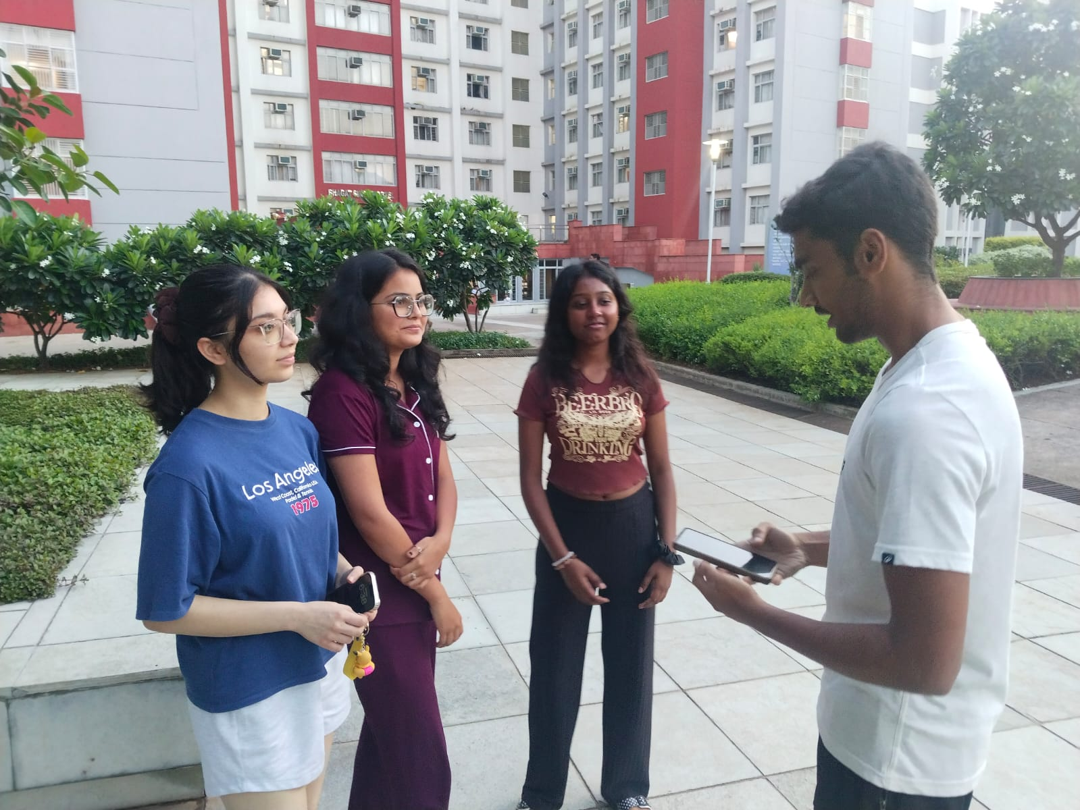
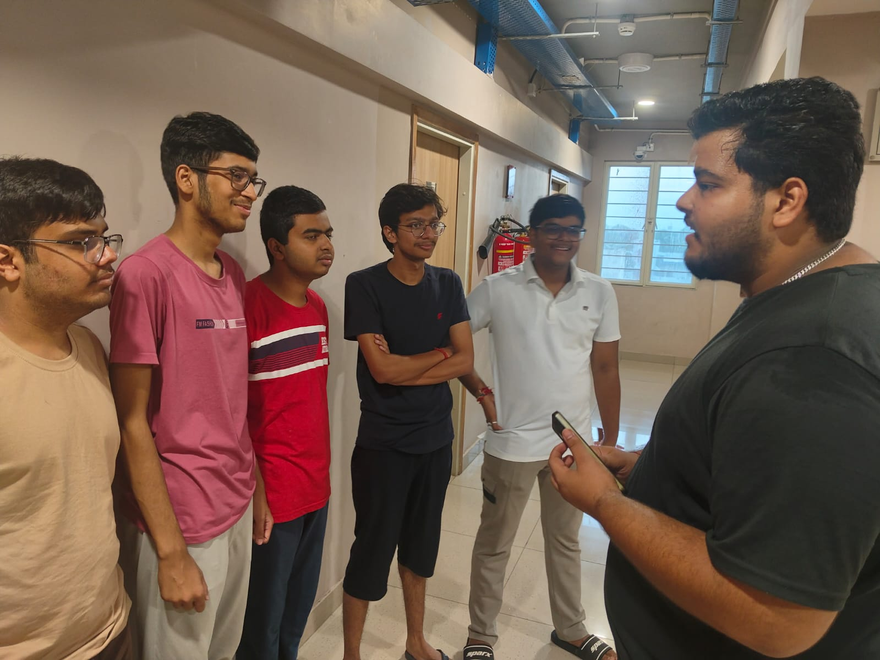
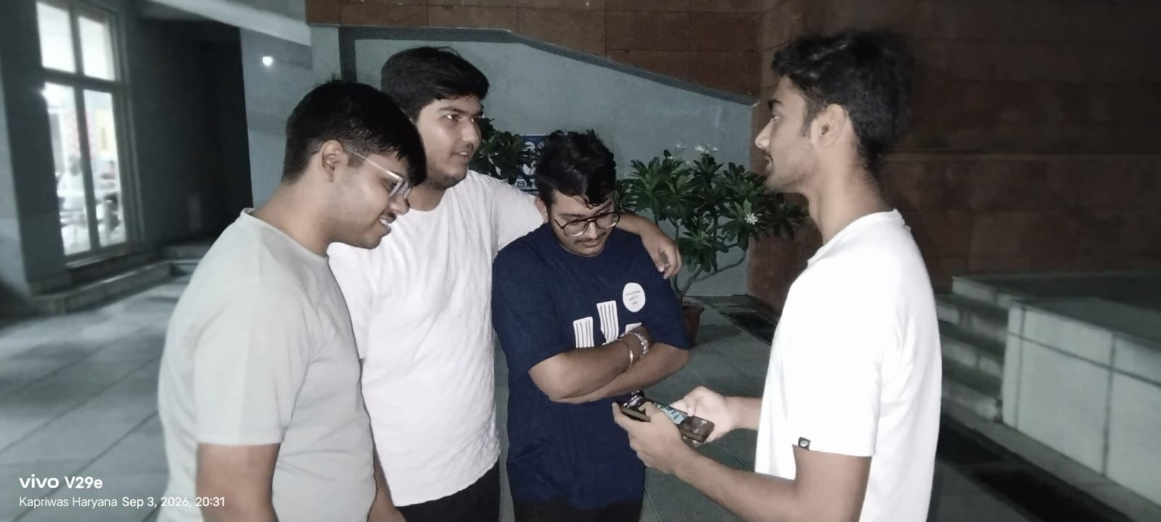
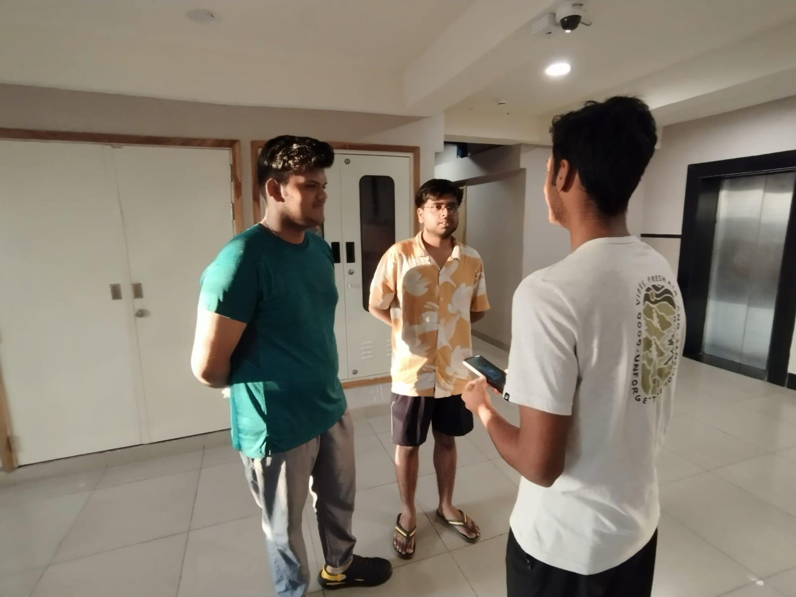
https://docs.google.com/spreadsheets/d/1NPTeHnFj_1-AMiTLPtSeWhpZ5RgCSdC-/edit?usp=drivesdk&ouid=104720566761637180129&rtpof=true&sd=true

Slide 10
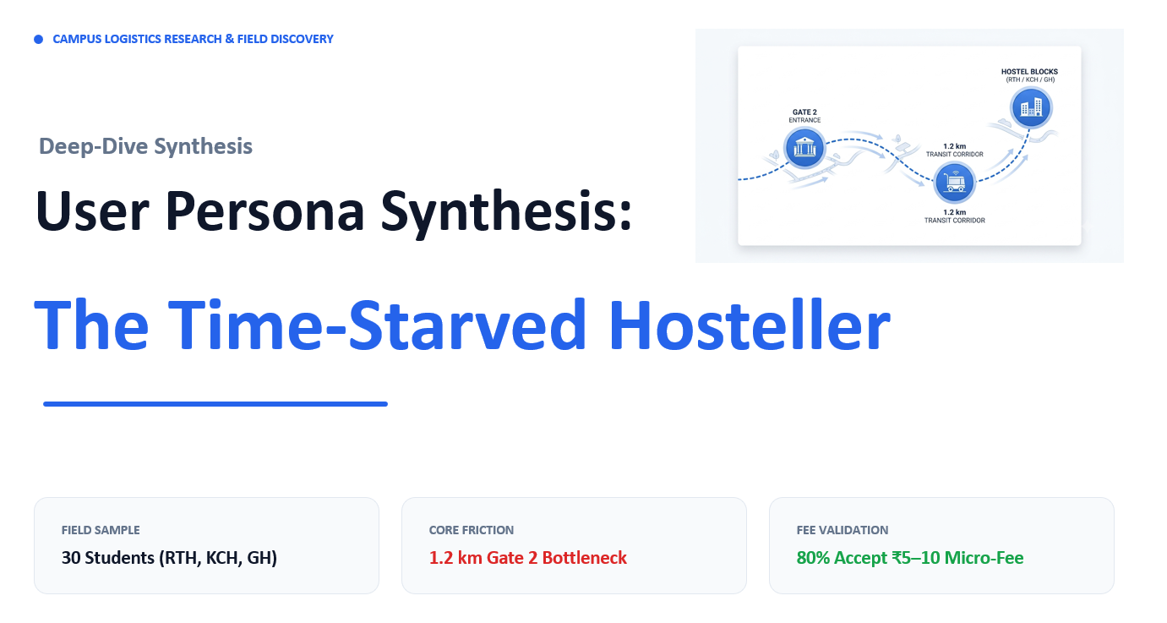
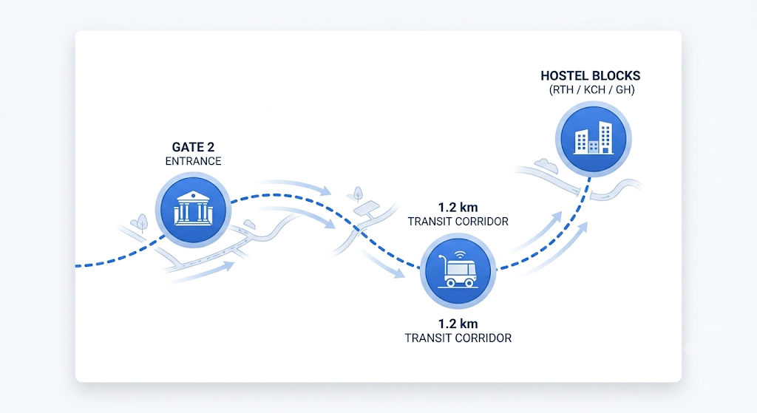
CAMPUS LOGISTICS RESEARCH & FIELD DISCOVERY
Deep-Dive Synthesis
User Persona Synthesis:
The Time-Starved Hosteller
FIELD SAMPLE
CORE FRICTION
FEE VALIDATION
30 Students (RTH, KCH, GH)
1.2 km Gate 2 Bottleneck
80% Accept ₹5–10 Micro-Fee

Slide 11


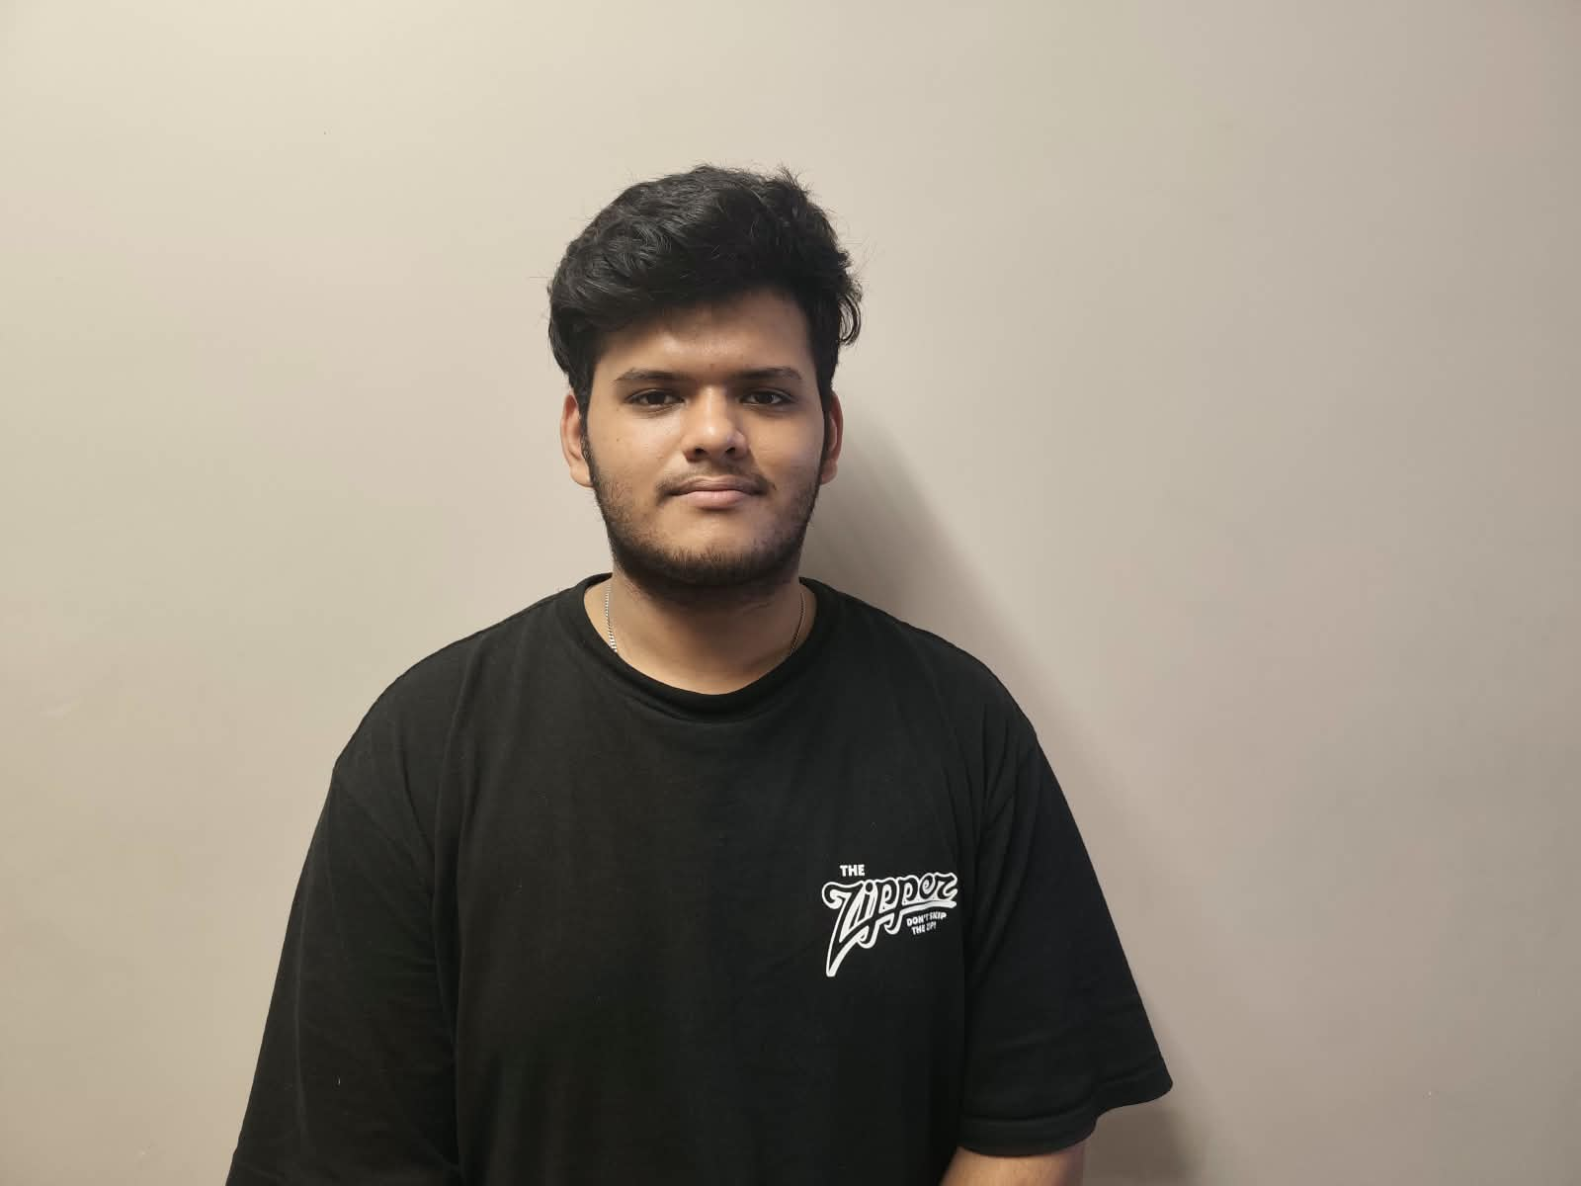



PRIMARY ARCHETYPE
Chaitanya Bohra — The Academic Striver
Represents 78% of Hostellers
18 Years • 1st Year B.Tech
Needs & Desires
Resident, Ratan Tata Hostel (RTH)
Direct parcel drop at hostel building entrance.
Intensive daily academic schedule. Orders essentials on Blinkit and Swiggy 3–4 times weekly during evening project sprints.
Zero disruption during crunch study blocks.
Secure handover without lost packages.
"Walking 1.2 km to Gate 2 after grueling labs ruins the whole convenience of ordering online."
KEY DRIVERS
Frustrations & Friction
Time Preservation
Night Convenience
95%
88%
25 minutes lost per trip walking to Gate 2.
Cold food and delays during night study hours.
Inconvenience of asking roommates for favors.

Slide 12




SENSORY & BEHAVIORAL SYNTHESIS
Decoding The Hosteller's Sensory Experience
Thinking & Feeling
Hearing
Internal Doubt: "Why walk 1.2 km just for one urgent snack?"
Rider Calls: "Bhaiya, parcel Gate 2 pe hai."
Exhaustion: Heavy reluctance after lengthy day classes.
Roommate Favors: "Can you pick up my order too?"
Safety Hesitation: Discomfort during late night hours.
Peer Buzz: Frequent complaints regarding campus distance.
Seeing
Saying & Doing
Gate Barriers: Delivery riders halted at main security post.
Procrastination: "I'll go pick it up in 15 minutes."
The Trudge: Students walking 800m carrying meal packages.
Reluctant Walks: Forcing the trek despite heavy tiredness.
Poor Lighting: Dim pathways during late post-dinner pickups.
Delegation: Passing off pickup tasks to peers and friends.

Slide 13
FIELD SURVEY RESULTS
Sample: RTH • KCH • GH
Quantitative Validation Across 30 Hostellers
47%
1.2 km
80%
93%
Heavy Users (3+ times/wk)
Round-Trip Gate Distance
Willing to Pay ₹5–10 Fee
Adoption or Referral Intent
Current State Friction (Gate 2)
Persona-Validated Solution Fit
Campus Restriction: External riders barred from entering campus gate.
Autonomous Transfer: Gate 2 post feeds directly to internal cart fleet.
Time Tax: Students lose 20–25 minutes from study sessions.
Direct Doorstep: Automated delivery straight to all 7 hostel block foyers.
Physical Toll: Extreme fatigue in harsh weather and late hours.
Unit Economics: ₹5–10 micro-fee validated for economic sustainability.

Slide 14



STRATEGIC OPPORTUNITY
How Might We Bridge The Gate-To-Hostel Gap?
03
Micro-Fee Viability
Seamless ₹5–10 automated micro-charge aligned with 80% confirmed student willingness to pay.
02
Secure OTP Handover
01
Compartmentalized locker boxes unlocked via app OTP at the hostel building entrance.
Autonomous Fleet
Sensor-guided carts traversing internal pathways connecting Gate 2 to all 7 hostel blocks.

